Slide 1
Sprite Editor
2D Essentials

Slide 2
Objectives
How to create rounded corners for your game
How to use Unity sprite editor
How to slice sprite in Unity
How to use tiled sprite
How to create rounded button image
Repository Link:
Unity Documentation: https://docs.unity3d.com/Manual/9SliceSprites.html

Slide 3
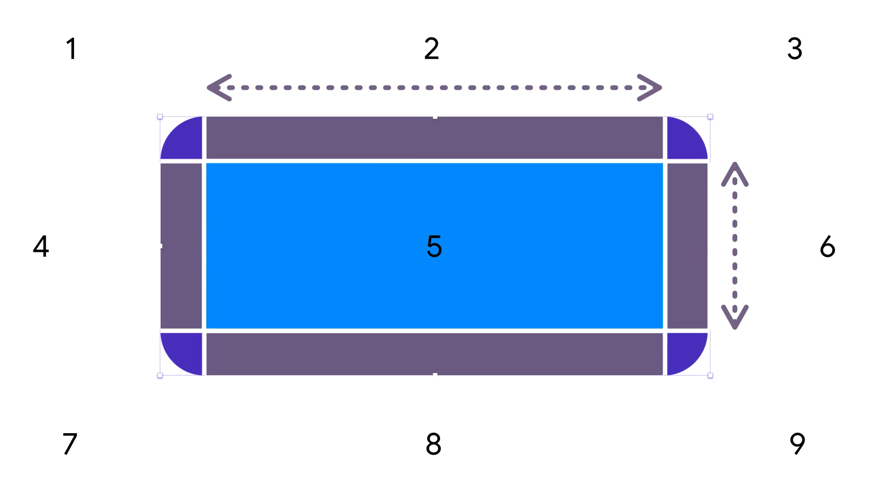

Slide 4
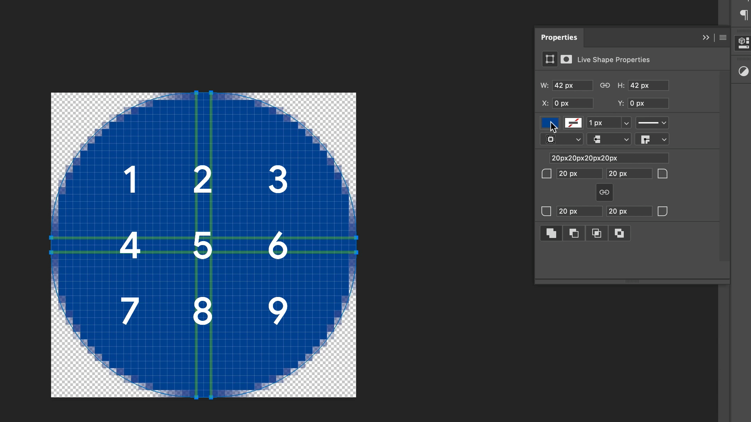

Slide 5
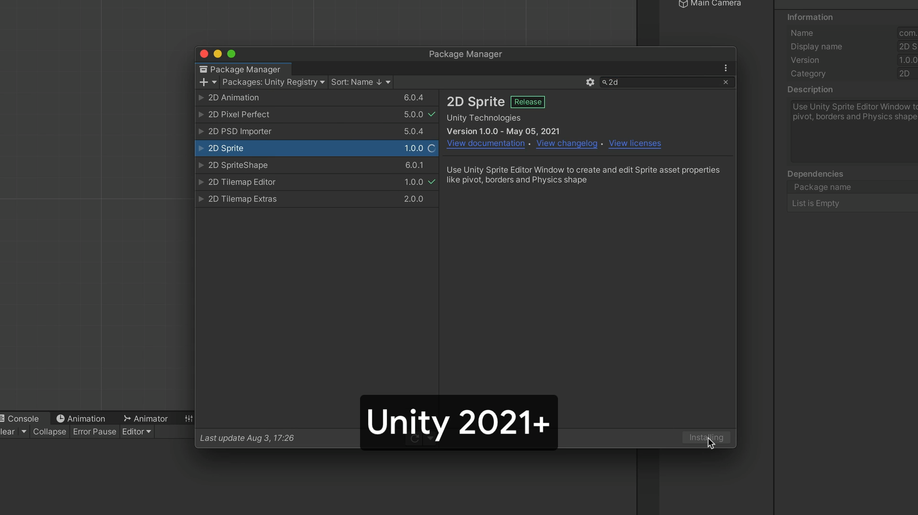

Slide 6
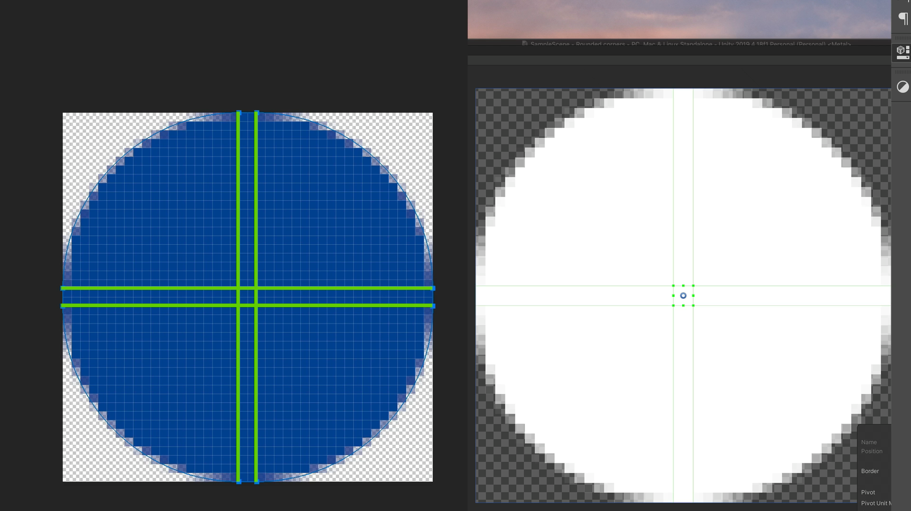

Slide 7
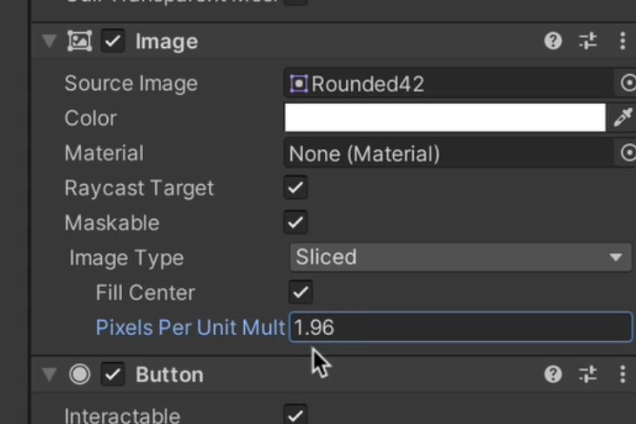
Be aware it can make corners a little bit too pixelated!

Slide 8
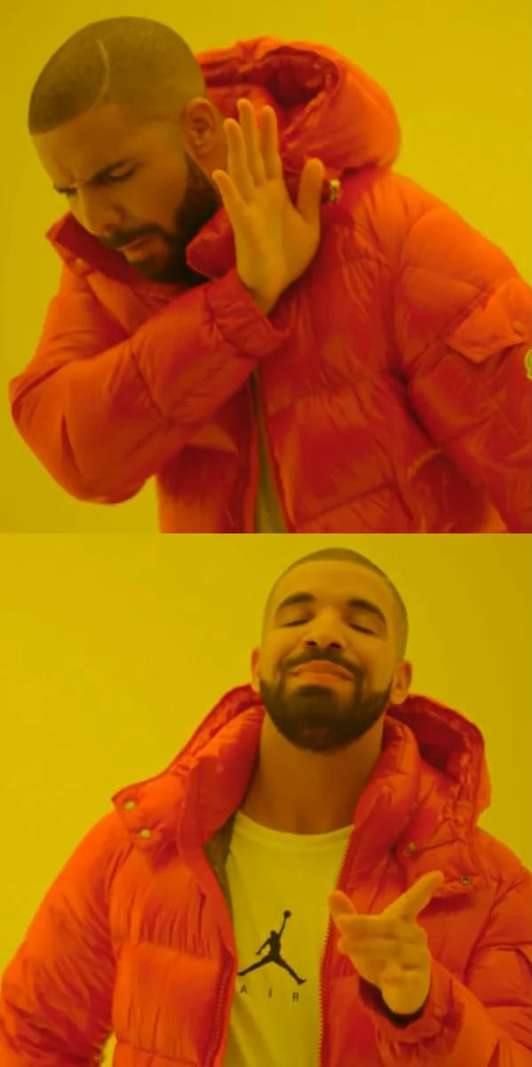

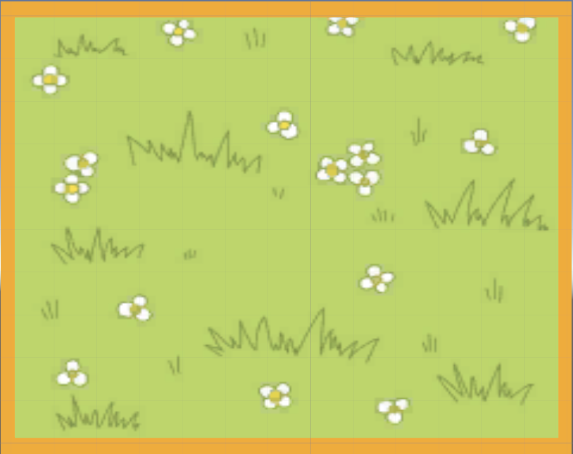

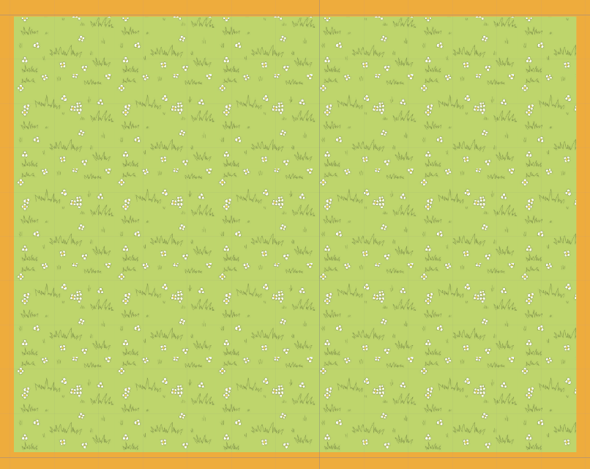

Slide 9
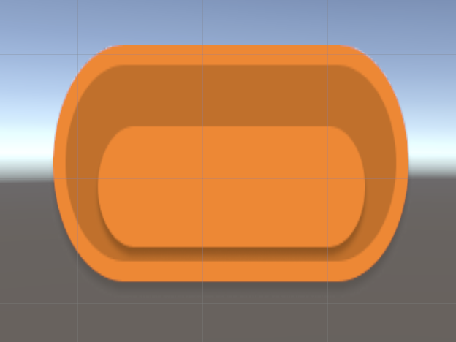
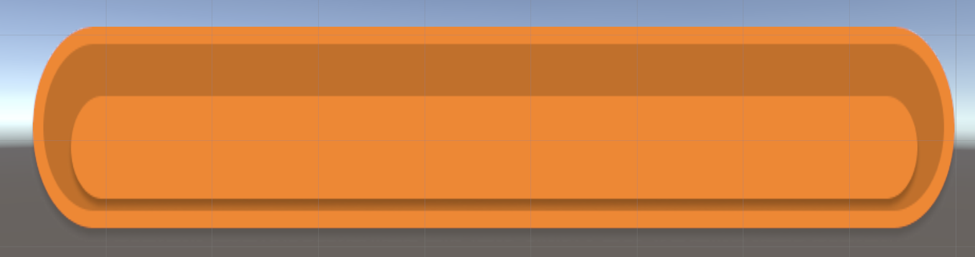
PROBLEM
?
?
?
?
?
?

Slide 10
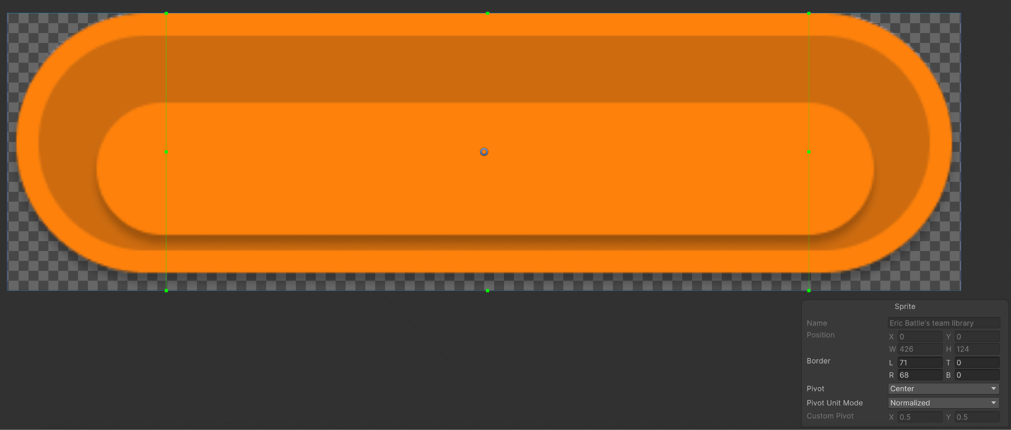
SOLUTION

